Slide 1
How Can Fathers Be Good Leaders?
Gaining Good Homes!
Part 2

Slide 2
Previously
Godly Families – the endangered species
Male Leadership Deficit (Ezek. 22:30; Jer. 5:1-9)
Men can stand in the gap to lead in:
Work-ethic
Spiritual and sensible education

Slide 3
3. Leading In Discipline
With education comes discipline
Discipline is a friend of education
Education without discipline may be merely academic
The father leads a disciplined life and disciplines behavior which is nonconforming
Notes:
“The rod and rebuke give wisdom, But a child left to himself brings shame to his mother” (Prov. 29:15).

Slide 4
“And you, fathers, do not provoke your children to wrath, but bring them up in the training and admonition of the Lord” (Eph. 6:4)
“Chasten your son while there is hope, And do not set your heart on his destruction” (Prov. 19:18)
“Whoever loves instruction loves knowledge, But he who hates correction is stupid” (Prov. 12:1)
“A wise son heeds his father’s instruction, But a scoffer does not listen to rebuke” (Prov. 13:1)
Notes:
RE: Prov. 19:18, there is a time when correction is hopeful for your child. There is a time when they are more pliable. The idea here is that when discipline is set aside, a worse punishment is coming (cf. Pr. 23:13, 14).

Slide 5
4. Leading In A Spiritual Walk
Leading family in prayer (1 Tim. 2:8)
Having good conduct (1 Tim. 3:2)
Teaching the commandments of God (1 Tim. 3:2; Is. 38:19; Gen. 18:18, 19; Josh. 4:21-24; Ps. 78:3-6)
Taking the oversight of the house (1 Tim. 3:4, 5)
Bringing family to worship (Josh. 24:15)
Notes:
Having good conduct. Do not do what you would not want your children to do and do what you want them to imitate.

Slide 6
Young Men
“Likewise exhort the young men to be sober-minded” (Titus 2:6)
“I go the way of all the earth; be strong, there-fore, and prove yourself a man” (1 Kin. 2:2)
Notes:
Prove yourself a man! You prove what you are. You are called to prove yourself a man. Look to the Bible to see what a real man looks like. Look to the example of Jesus. Do not look at Hollywood’s version of Jesus. Do not look at the denominational version of Jesus. But look to the gospel version of Jesus and behold the Man. Walk in his steps.
You will be met with opposition when you chose to live as a man. The world does not like real men and it will not like you. But you must rise above the world’s criticism. You must face opposition. You must lead in righteousness or you will follow in unrighteousness. You must work for God as a man. You must be the head of your family as a man. You must treat your wife and children the way a man is supposed to. You must lead them as God expects you to do.

Slide 7
“Likewise exhort the young men to be sober-minded” (Titus 2:6)
What Manliness Is Not
Manliness ≠ Recklessness (Judg. 9:4)
Manliness ≠ Rudeness (1 Cor. 13:5)
Manliness ≠ Laziness (Prov. 24:30-34)
Manliness ≠ Filthiness (1 Cor. 6:20; Deut. 23:12-14; 1 Pet. 3:21)
“…prove yourself a man…” (1 Kin. 2:2)
Notes:
Some may object and ask, “what is all the fuss about what we do with the body?” “God looks at the heart and does not care how we treat the body.” Neglect of the body does not make you spiritual (Col. 1:22, 23). Men should pursue good hygiene (this French word has at its base the Greek word for “living well”). Further we read, “…glorify God in your body and in your spirit, which are God’s” (1 Cor. 6:20). How am I glorifying God if I dress like girl, a gangster, if I wear hair like a girl, or display an unkempt presentation of myself? It is not masculine to let the body go. It is lazy. It does not glorify God to lack personal hygiene. The Old Testament is filled with hygienic teaching all over (consider Deut. 23:12-14 and note warning in v. 14. Is our “camp” holy?” Even cleanliness was understood by the recipients of Peter’s first letter as he had to clarify that baptism was not the washing away of the filth of the flesh, which necessarily implies that they understood there was a time and practice of washing away the filth of the body (1 Pet. 3:21).

Slide 8
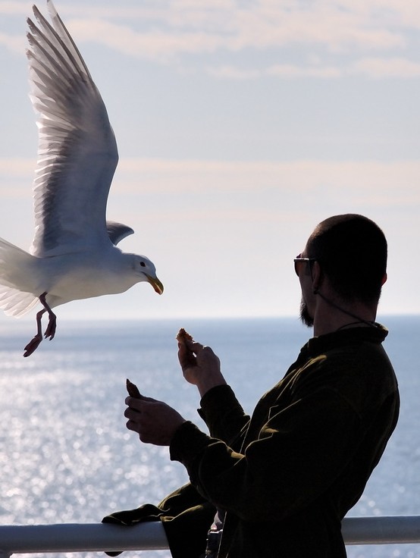
Prove Yourself A Man
“A woman shall not wear anything that pertains to a man, nor shall a man put on a woman’s garment, for all who do so are an abomination to the LORD your God” (Deut. 22:5)
Notes:
God created mankind as male and female (Gen. 1:27). Each are distinct from the other and He expects that distinction to remain clear. The blurring of this is an abomination.

Slide 9
Prove Yourself A Man
“…and you are not your own? For you were bought at a price; therefore glorify God in your body and in your spirit…” (1 Cor. 6:19, 20)
DISTINCTION
Dress
Hair
Demeanor
Role
Rule
Notes:
DRESS– Your dress reflects a lot about you. It reflects how much you value and respect yourself. It reflects your self-worth. Dress to seek attention from others suggests to me that you are unsure about yourself. That you need to find your self-worth by what others think or notice about you. Many of the youth today have an identity problem. Women dress in such a way to draw the eyes of men upon them.
Boys also. I guess many do not know what a man is to look like. I see them walking around wearing pants that are two sizes too large. They are falling down every step they take. I don’t know what they are trying say. Is it a code that they view themselves too small to wear the pants of manhood? Young men used to make fun of others in jest saying that “your Momma must dress you.” But this style shows that without their mother, they truly do not know how to dress!
HAIR – consider 1 Cor. 11:14, 15; Revelation 9:8.
DEMEANOR – consider 1 Pet. 3:4; 1 Cor. 6:9, “homosexuals” (KJV, effeminate, defined as soft, soft to touch, see Lk. 7:25; here it is metaphorical for a homosexual.)
ROLE – 1 Pet. 3:1ff; Eph. 5:22, 23
RULE - 1 Tim. 3:4

Slide 10
Created To RULE (Gen. 1:28)!
DOMINION
“You have made him to have dominion over the works of Your hands; You have put all things under his feet” (Ps. 8:6)
Notes:
Man was created to rule.

Slide 11
Created To RULE (Gen. 1:28)!
DOMINION
“I said, ‘You are gods, And all of you are children of the Most High”(Ps. 82:6)

Slide 12
Created To RULE (Gen. 1:28)!
DOMINION
+
“SUBDUE”
“TEND & KEEP”
Tread Down
Fear and Dread
Serve Guard and Protect
(Gen. 9:2)
(Gen. 2:15)

Slide 13
CAN WE AT LEAST RULE
Our spirit (Prov. 16:32; 25:28)
Our body (1 Thess. 4:1-6)
“That no man should by any means endeavour to corrupt the wife of another, or to alienate her affections or fidelity from her husband…” (Adam Clarke, comm. on v. 6)
Our house (1 Tim. 3:4, 5)
Notes:
The sphere of our family, that wife, the children and all associated with our house out to be our kingdom whereby we rule. We ought to strive to be the lion of our tribe rather or the alpha male in our pack. We ought to bring forth and carry out our rules. We ought to provide for our family the necessities of life as well as the spiritual education and preparation for heaven. We ought to be willing to dominate bad behavior and lead by example what is proper. We ought to be willing to display a protective love for our house that if need be, we, like the Lion of the tribe of Judah, will lay down our life to preserve and save it.

Slide 14
REVIEW OF PART 1, 2
How I Can Be A Good Leader
Modeling A Work-ethic
Guiding In Education
Administering Discipline
Walking The Spiritual Walk
Exhortation: “Prove Yourself A Man”
Noting What Is Not Manliness
Distinguishing Yourself As A Man

Slide 15
1 John 2:13, 14
13 I write to you, fathers, Because you have known Him who is from the beginning. I write to you, young men, Because you have overcome the wicked one. I write to you, little children, Because you have known the Father.
14 I have written to you, fathers, Because you have known Him who is from the beginning. I have written to you, young men, Because you are strong, and the word of God abides in you, And you have overcome the wicked one.

Slide 16
1 John 2:13, 14
1
13 I write to you, fathers, Because you have known Him who is from the beginning. I write to you, young men, Because you have overcome the wicked one. I write to you, little children, Because you have known the Father.
14 I have written to you, fathers, Because you have known Him who is from the beginning. I have written to you, young men, Because you are strong, and the word of God abides in you, And you have overcome the wicked one.
2
3
Notes:
John, in this text speaks to three ages of Christians and is likely narrowing in on the men of God. The children or babes in Christ should know that their sins are forgiven (see v. 12). That they have known the Father.
The fathers, John states twice that they have known him who is from the beginning. Likely this is their seasoned mature understanding of Jesus Christ, the pre-existent Son of God.
Then John writes to the young men. These are young men. They are vigorous victors. They have overcome Satan. We learn why in verse 14. They are strong. The strength they have is what enabled them to defeat Satan. We learn where their strength comes from…the indwelling word of God!
Young men, listen up. Some of you may be graduating from high school or from college or from one station in life to another. I want to impress upon you in this lesson the weight that God has placed on you to be strong in the word. Whatever Satan will throw at you in the years to come can be met with a Bible in your hand and a Bible in your head. The word must abide in you. Your success is not in how much money you can make, not in the kind of house you own or the car you drive.
Your success in this trial we call life, is measured by how you think, how you stand and how you love (see 1 Jn. 2:15ff). Satan is going to throw curve balls at you. He is going to advertise wickedness in the package of pleasure. He is going to provide you opportunities to excel. He will appeal to your pride and lust. The decisions you make on a daily basis will not only define your life, but will bring consequences, not only to you and your soul, but to others and most certainly to those who love you the most. Will God write John 2:14 as an epitaph of your life? Only so if the word abides in you in the places you go, the decisions you make, the jobs you take, the things you see and do. Will you become good leaders today? Will you stand in the gap?

